Slide 1

The future economy
– changes, challenges, and adjustments
Bernard Yeung
Dean and Stephen Riady Distinguished Professor
NUS Business School
October 2016, Shanghai China

Slide 2

Agenda
Age of the Fourth Industry Revolution
  Exciting but disruptive changes
Five stressful paradoxes provide guidance for us
Implications
  Students
  University

Slide 3

Why the excitement ?
Inventions push human development, unlike other creatures, we find means to
  Expand our intelligence: writing, printing, computer, internet, ….
  Expand our physical reach – wheel, horse, ships and water ways, trains railroads and high speed trains, cars and highways, airplane and airports, ….
  Expand ways to meet needs – fire, energy, machine tools, synthetic materials, …
  Improve our heath and life horizon– medicine, penicillin, … genome editing, stem cell, …..
  Develop human organizations that improve everyone’s life – division of labor, production process, corporatization, paper money, banks, bonds, joint stock companies, shared economy …

Slide 4
Why is the Fourth Industrial Revolution exciting?
The 4th Industrial Revolution has all five developments simultaneously:
  Internet, big data analysis, artificial intelligence/machine learning, quantum computing
  Drones, driverless cars, GPS
  Material science, energy storage, 3D printing, robots, nanotechnology,
  Stem cells, genome editing, computational biology,…
  Share economy – Uber, Didi,
Rapid developments of new products, new processes, new organizations, …. with depth, wide scope and at exponentially speed

Slide 5



Three fundamentally disruptive changes
Disruptive impact on human behavior – connectivity and information processing
  How do we get information? Internet search
  How do we relate to people? Facebook, blog, qq, less for real time
  How do we consume? shopping, eating, travel via IT and crowd sourcing
  How do we treat our health?
  How do we think? Youngsters doing math
Disruptive impact on organizational behavior (business models)
  Shared model (Uber-Didi)
    Lawrence Katz and Alan Krueger: the proportion of American workers engaged in “alternative work arrangements” increased from 10% in 2005 to 16% in late 2015
  Disintermediation because of Informed and connected buyers and sellers
    Platform to for capabilities, e.g., Alibaba raised $25 billion in its IPO
    Crowd sourcing – user feedback and recommendation, Flipkart, Yelp, Siksin, eFarming, ,,,,
  E-Payments and financial intermediation create inclusiveness: e-payment, e-finance, e-currency
Disruptive impact on expectations on government
  Social media affects election and governing
  Intellectual property – open sourcing vs proprietary
  Cyber Security
  Financial regulations – fin-tech, e-currency

Slide 6
Three fundamentally disruptive changes
Disruptive impact on human behavior – connectivity and information processing
  How do we get information? Internet search
  How do we relate to people? Facebook, blog, qq
  How do we consume? shopping, eating, travel via IT and crowd sourcing
  How do we treat our health?
  How do we think? Youngsters doing math
Disruptive impact on organizational behavior (business models)
  Shared model (Uber-Didi)
    Lawrence Katz and Alan Krueger: the proportion of American workers engaged in “alternative work arrangements” increased from 10% in 2005 to 16% in late 2015
  Disintermediation because of Informed and connected buyers and sellers
    Platform to for capabilities, e.g., Alibaba raised $25 billion in its IPO
    Crowd sourcing – user feedback and recommendation, Flipkart, Yelp, Siksin, eFarming, ,,,,
  E-Payments and financial intermediation create inclusiveness: e-payment, e-finance, e-currency
Disruptive impact on expectations on government
  Social media affects election and governing
  Intellectual property – open sourcing vs proprietary
  Cyber Security
  Financial regulations – fin-tech, e-currency

Slide 7
Three fundamentally disruptive changes
Disruptive impact on human behavior – connectivity and information processing
  How do we get information? Internet search
  How do we relate to people? Facebook, blog, qq
  How do we consume? shopping, eating, travel via IT and crowd sourcing
  How do we treat our health?
  How do we think? Youngsters doing math
Disruptive impact on organizational behavior (business models)
  Shared model (Uber-Didi)
    Lawrence Katz and Alan Krueger: the proportion of American workers engaged in “alternative work arrangements” increased from 10% in 2005 to 16% in late 2015
  Disintermediation because of Informed and connected buyers and sellers
    Platform to for capabilities, e.g., Alibaba raised $25 billion in its IPO
    Crowd sourcing – user feedback and recommendation, Flipkart, Yelp, Siksin, eFarming, ,,,,
  E-Payments and financial intermediation create inclusiveness: e-payment, e-finance, e-currency
Disruptive impact on expectations on government
  Social media affects election and governing
  Intellectual property – open sourcing vs proprietary
  Cyber Security
  Financial regulations – fin-tech, e-currency
  Technology and big data enhance control and service

Slide 8
Stresses and paradoxes
The education sector develops knowledge and trains students for the future
  The disruptions clearly present unknowns and numerous challenges
Seek guidance and develop insights by examining intellectual tensions:
  Data rich but truth poor
  Level the playing field but winners take more
  Exciting investment prospects but low investment, low return, low growth, high savings, and high cashholding
  Deglobalization but actually globalizing
  Originated from DMs but EMs leapfrog forward
    Understand the downside to see the upside

Slide 9
Stresses and paradoxes
The education sector develops knowledge and trains students for the future
  The disruptions clearly present unknowns and numerous challenges
Seek guidance and develop insights by examining intellectual tensions:
  Data rich but truth poor
  Level the playing field but winners take more
  Exciting investment prospects but low investment, low return, low growth, high savings, and high corporate cashholding
  Deglobalization but actually globalizing
  Originated from DMs but EMs leapfrog forward
    Understand the downside to see the upside

Slide 10

1. Data rich but truth poor
“Information” commoditized (via internet surge), big data, but a pseudo sense of knowing
    Internet information can be fake or confusing
    Big data can create sample bias/mistakes
      Gary King (Harvard) used social media to predict unemployment, correlating US unemployment figures with words in social media like ‘jobs’, ‘unemployment’ and ‘classifieds’ – has to deal with the spike of “jobs” when Steve Jobs died
    Correlation is not causation
      Many people are happy while drinking, should governments supply more bars?
    Feedback effect destroys validity
      Someone discovered in 2013 that people who kept their browsers up to date performed better at their jobs, but as soon as the metric was widely known it became useless as job-hunters altered their behavior.

Slide 11
1. Data rich but truth poor
“Information” commoditized (via internet surge), big data, but a pseudo sense of knowing
    Internet information can be fake or confusing
    Big data can create sample bias/mistakes
      Gary King (Harvard) used social media to predict unemployment, correlating US unemployment figures with words in social media like ‘jobs’, ‘unemployment’ and ‘classifieds’ – has to deal with the spike of “jobs” when Steve Jobs died
    Correlation is not causation
      Many people are happy while drinking, should governments supply more bars?
    Feedback effect destroys validity
      Someone discovered in 2013 that people who kept their browsers up to date performed better at their jobs, but as soon as the metric was widely known it became useless as job-hunters altered their behavior.

Slide 12
1. Data rich but truth poor
“Information” commoditized (via internet surge), big data, but a pseudo sense of knowing
    Internet information can be fake or confusing
    Big data can create sample bias/mistakes
      Gary King (Harvard) used social media to predict unemployment, correlating US unemployment figures with words in social media like ‘jobs’, ‘unemployment’ and ‘classifieds’ – has to deal with the spike of “jobs” when Steve Jobs died
    Correlation is not causation
      Many people are happy while drinking, should governments supply more bars?
    Feedback effect destroys validity
      Someone discovered in 2013 that people who kept their browsers up to date performed better at their jobs, but as soon as the metric was widely known it became useless as job-hunters altered their behavior.

Slide 13
1. Data rich but truth poor
“Information” commoditized (via internet surge), big data, but a pseudo sense of knowing
    Internet information can be fake or confusing – “Clinton vs Trump, who won the debate on Sept 26t 2016?”
    Big data can create sample bias/mistakes
      Gary King (Harvard) used social media to predict unemployment, correlating US unemployment figures with words in social media like ‘jobs’, ‘unemployment’ and ‘classifieds’ – has to deal with the spike of “jobs” when Steve Jobs died
    Correlation is not causation
      Many people are happy while drinking, should governments supply more bars?
    Feedback effect destroys validity
      Someone discovered in 2013 that people who kept their browsers up to date performed better at their jobs, but as soon as the metric was widely known it became useless as job-hunters altered their behavior.

Slide 14

Data rich = false confidence, truth poor = make mistakes
  Need: Judgment, critical and causal thinking

Slide 15
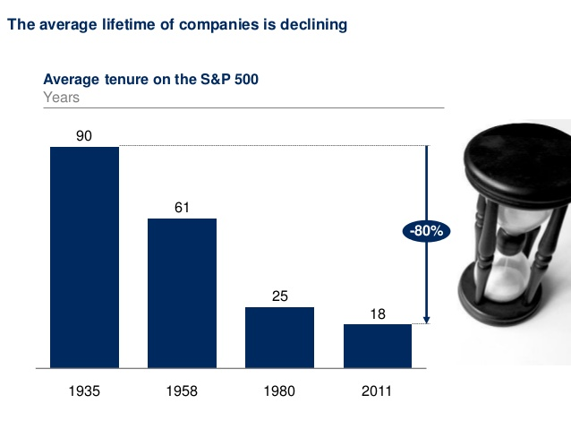
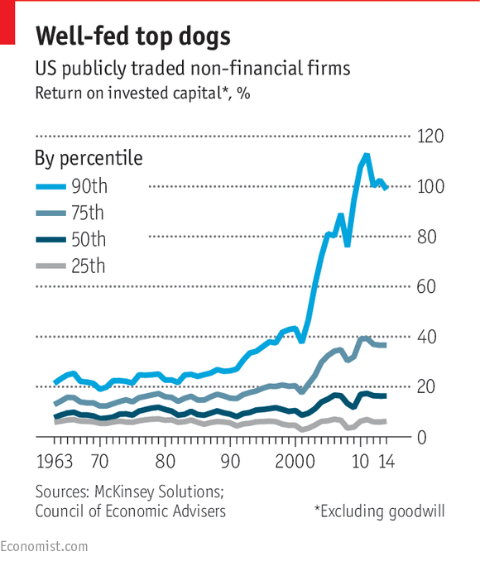
2. Digitalization level the playing field, but winners take more
Fast culling
Winner take more
  10% of the world’s public companies generate 80% of all profits (The McKinsey Global Institute)

Slide 16
Level the playing field but winners take more
Winners take more using two approaches:
  Amass direct control of core capabilities (a global bullish M&A market)
    In 1990’s there were 11,500 M&A deals, a combined value equivalent to 2% of global GDP,
    since 2008 the number has risen to 30,000 a year, worth about 3% of global GDP.
  Labor-asset light, but use technology to link up with other capabilities
    Platforms and coordinators of capabilities
      “Platforms” to connect different groups of people and allow them to engage in mutually beneficial exchanges.
        Pankaj Ghemawat – America’s top 1,000 public companies now derive 40% of their revenue from alliances, compared with just 1% in 1980.
    In 1990 the top three carmakers in Detroit: revenues of $250 billion, market capitalisation $36 billion and 1.2m employees.
    In 2014 the top three companies in Silicon Valley: revenues of $247 billion, market capitalisation $1 trillion and 137,000 employees.

Slide 17
Level the playing field but winners take more
Winners take more using two approaches:
  Amass direct control of core capabilities (a global bullish M&A market)
    In 1990’s there were 11,500 M&A deals, a combined value equivalent to 2% of global GDP,
    since 2008 the number has risen to 30,000 a year, worth about 3% of global GDP.
  Labor-asset light, but use technology to link up with other capabilities
    Platforms and coordinators of capabilities
      “Platforms” to connect different groups of people and allow them to engage in mutually beneficial exchanges.
        Pankaj Ghemawat – America’s top 1,000 public companies now derive 40% of their revenue from alliances, compared with just 1% in 1980.
    In 1990 the top three carmakers in Detroit: revenues of $250 billion, market capitalisation $36 billion and 1.2m employees.
    In 2014 the top three companies in Silicon Valley: revenues of $247 billion, market capitalisation $1 trillion and 137,000 employees.

Slide 18

Yes, fast culling and winners take all, but, everyone has a role to play
Lesson: everyone can contribute, need a thick radar screen, connect the dots, contribute to a value-adding community (shared economy)

Slide 19
3. Innovations mean exciting investment prospects; but 3 lows (investment, return, growth) and 2 highs (savings, cashholding)?
Two hypotheses: the secular stagnation and savings glut hypotheses
  Secular Stagnation:
    Technological progress and ageing populations shrink investment opportunities
      Larry Summers, http://larrysummers.com/2016/02/17/the-age-of-secular-stagnation/
  Savings glut
    policy-distorted high savings from emerging economies
    longer life expectations = need more savings, and low interest rate raises the pension burden.
      Ben Bernanke https://www.brookings.edu/blog/ben-bernanke/2015/04/01/why-are-interest-rates-so-low-part-3-the-global-savings-glut/.
Notes:
See Larry Summers, http://larrysummers.com/2016/02/17/the-age-of-secular-stagnation/
See Ben Bernanke https://www.brookings.edu/blog/ben-bernanke/2015/04/01/why-are-interest-rates-so-low-part-3-the-global-savings-glut/.
There will be no shortage of industry survey showing firms are investing in “things” of the Fourth Industrial Revolutions. However, note that these surveys often have a sampling bias. Furthermore, Figure 1.13 of IMF’s World Economic Outlook April 2016 show that the world’s real investment has been flat since 2010, and that is the case for advanced countries or Emerging and Developing Economies.
Thomas Piketty’s Capital in the Twenty-First Century (2014) draws our attention to the rising share of capital income and rising economic disparity. The culprit is a highly elastic substitution between capital and labour. When the substitution is too elastic, technological progresses can reduce labour income share and earnings.
Future technological progresses may do exactly that. “Uberization” likely reduces the number of cars needed. With driverless cars, Uber does not need to employ drivers to deliver an adequate car-ride service. The result is high job-displacement at low capital-cost where the capital owner gains handsomely. The gain is even greater if big data analysis allows greater extraction of consumer surplus, e.g., the ride fare doubles in heavy rain.
Consider also the introduction of robot adviser in selling insurance – the marginal training and monitoring cost are extremely low once the upfront investment is incurred. By introducing robot adviser developed in the US to sell insurance in China, an insurance company can cover the whole of China at very low marginal investment cost - a significant advantage in comparison to developing real-life insurance sales agents. The result is that any company introducing the innovation could capture a lion’s share of the China insurance market, while many Chinese insurance sales agents lose their jobs.
These stories illustrate how the current technological revolution may drive high capital labour substitution resulting in large-scale job destruction and wide income disparity in favour of capital owners and high-end professionals. Indeed, the revolution heightens the winner-takes-all phenomenon. Needless to say, such high income disparity is undesirable and can lead to a vicious cycle that further retards job creation.
Generating inclusive growth is a non-trivial challenge in the age of Fourth Industrial Revolution. Our government has to raise Singaporeans’ awareness of the need, and to stimulate their effort, to adjust in advance: develop skills that complement technological innovations and avoid building their livelihood on skills that are machine substitutable.
Our government has to encourage Singaporeans to develop skills that complement technological innovations and avoid building their livelihood on skills that are machine substitutable.
High elasticity of substitution means that laborers can be easily replaced by machines at low investment cost. In such a case, capital investment reduces labor income share.
There are plenty of examples of corporate heroes becoming zeros: think of BlackBerry, Blockbuster, Borders and Barings, to name just four that begin with a “b”.

Slide 20
Overtly rapid disruption may be another explanation for 3 lows (investment, return, growth) and 2 highs (savings, cashholding)
Investment
  Expectations of highly frequent disruptive innovations → investments have high risk and short life-span of usefulness
  High information asymmetry → difficult to value
  Implications:
    discourages investment
    even expansion and replenish investments are reduced
    finance is by and large based on internal cash
Savings:
  Corporations hoard cash for future investment
  Highly elastic substitution of machines for jobs reduces job security
    Households save more
Implication – do not be fearful, take risk, take charge – disrupt or be disrupted
Notes:
See Larry Summers, http://larrysummers.com/2016/02/17/the-age-of-secular-stagnation/
See Ben Bernanke https://www.brookings.edu/blog/ben-bernanke/2015/04/01/why-are-interest-rates-so-low-part-3-the-global-savings-glut/.
There will be no shortage of industry survey showing firms are investing in “things” of the Fourth Industrial Revolutions. However, note that these surveys often have a sampling bias. Furthermore, Figure 1.13 of IMF’s World Economic Outlook April 2016 show that the world’s real investment has been flat since 2010, and that is the case for advanced countries or Emerging and Developing Economies.
Thomas Piketty’s Capital in the Twenty-First Century (2014) draws our attention to the rising share of capital income and rising economic disparity. The culprit is a highly elastic substitution between capital and labour. When the substitution is too elastic, technological progresses can reduce labour income share and earnings.
Future technological progresses may do exactly that. “Uberization” likely reduces the number of cars needed. With driverless cars, Uber does not need to employ drivers to deliver an adequate car-ride service. The result is high job-displacement at low capital-cost where the capital owner gains handsomely. The gain is even greater if big data analysis allows greater extraction of consumer surplus, e.g., the ride fare doubles in heavy rain.
Consider also the introduction of robot adviser in selling insurance – the marginal training and monitoring cost are extremely low once the upfront investment is incurred. By introducing robot adviser developed in the US to sell insurance in China, an insurance company can cover the whole of China at very low marginal investment cost - a significant advantage in comparison to developing real-life insurance sales agents. The result is that any company introducing the innovation could capture a lion’s share of the China insurance market, while many Chinese insurance sales agents lose their jobs.
These stories illustrate how the current technological revolution may drive high capital labour substitution resulting in large-scale job destruction and wide income disparity in favour of capital owners and high-end professionals. Indeed, the revolution heightens the winner-takes-all phenomenon. Needless to say, such high income disparity is undesirable and can lead to a vicious cycle that further retards job creation.
Generating inclusive growth is a non-trivial challenge in the age of Fourth Industrial Revolution. Our government has to raise Singaporeans’ awareness of the need, and to stimulate their effort, to adjust in advance: develop skills that complement technological innovations and avoid building their livelihood on skills that are machine substitutable.
Our government has to encourage Singaporeans to develop skills that complement technological innovations and avoid building their livelihood on skills that are machine substitutable.
High elasticity of substitution means that laborers can be easily replaced by machines at low investment cost. In such a case, capital investment reduces labor income share.
There are plenty of examples of corporate heroes becoming zeros: think of BlackBerry, Blockbuster, Borders and Barings, to name just four that begin with a “b”.

Slide 21

4. Deglobalization but actually globalizing
Brexit, Trump, Sanders fuel a deglobalization sentiment (no, they will not be the next US president)
Reality: the world is more globally connected than ever via the internet and “platform” firms which
  connect different groups of people to engage in mutually beneficial exchanges.
  connect corporate capabilities to serve buyers
    UNCTAD: the top 100 multinationals have an average of 20 holding companies each and more than 500 affiliates, operating in more than 50 countries

Slide 22
4. Deglobalization but actually globalizing
Brexit, Trump, Sanders fuel a deglobalization sentiment (no, they will not be the next US president)
Reality: the world is more globally connected than ever via the internet and “platform” firms which
  connect different groups of people to engage in mutually beneficial exchanges.
  connect corporate capabilities to serve buyers
    UNCTAD: the top 100 multinationals have an average of 20 holding companies each and more than 500 affiliates, operating in more than 50 countries

Slide 23
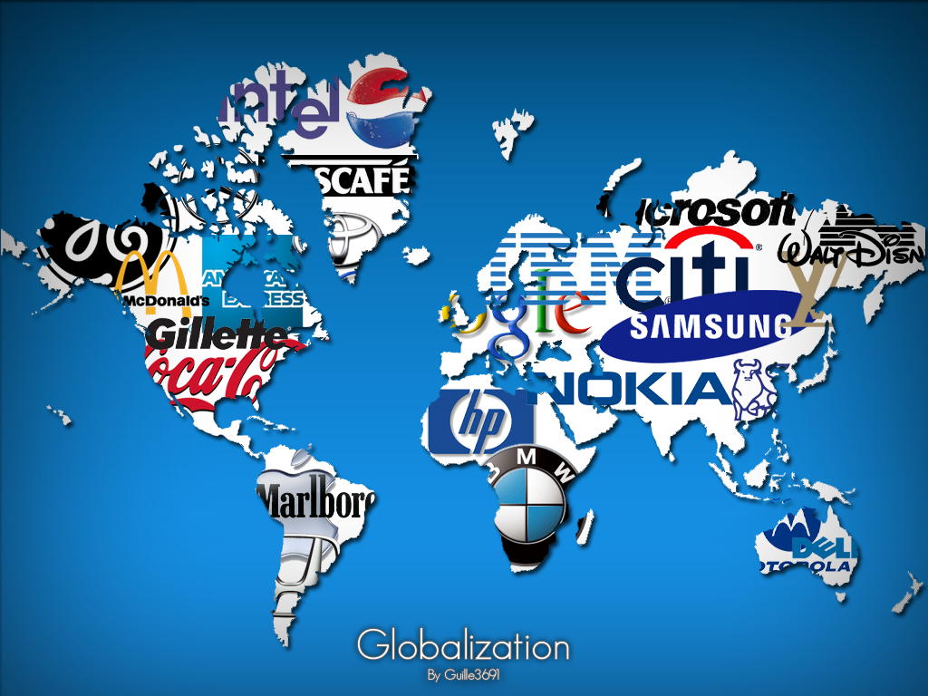
Corporatization vs Virtualization
On the one hand, corporatization:
  Reap enormous efficiencies by creating supply chains that stretch around the world, located cost-effectively, and involve hundreds of partners
On the other hand, virtualization
  Startups reach global markets with the help of platforms firms
Together, provide transformational experience for customers and providers

Slide 24
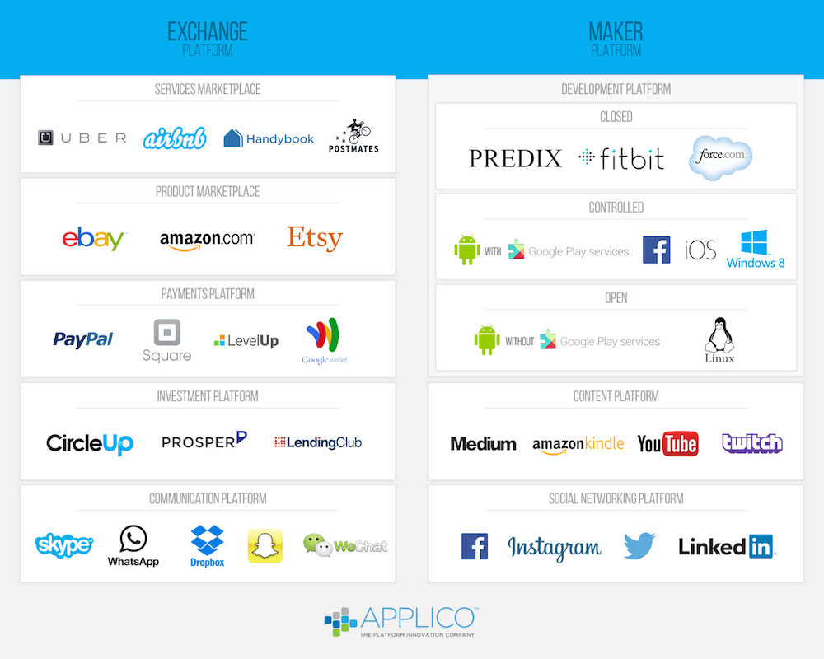
Deglobalization but actually globalizing
On the one hand, corporatization:
  Reap enormous efficiencies by creating supply chains that stretch around the world , located cost-effectively, and involve hundreds of partners
On the other hand, virtualization
  Startups reach global markets with the help of platforms firms
Together, provide transformational experience for customers and providers

Slide 25
Deglobalization but actually globalizing
Co-existence of corporatization and virtualization
  Develop economic rationality
  Turn yourself into an entrepreneur who contributes

Slide 26
5. Originate from DMs but EMs gets leapfrogging growth
Ironically, these revolutionary changes will benefit Asia tremendously precisely because the East is less developed than the West - leapfrog in progress.
Four reasons
  Disruptive innovation is “creative destruction;” destruction is less in Asia than in the less developed Asia
  Asset ownership and control is more concentrated in Asia than in the West
    Internalizes the synergies and externalities stemming from innovation efforts
    Diversify the risk of innovations
    Internal capital is more amply available.
  Asia is in need of infrastructure development and advanced logistics management
    ICT, big data analytics and robotic technology substantially reduce the cost and raise the effectiveness of logistics management and infrastructure development.
  Technology and ICT revolutionise market structures in Asia: creating disintermediation and financial inclusion (9 of top 20 of internet using countries are in Asia)
Lesson: care, dare, and value-add

Slide 27
5. Originate from DMs but EMs gets leapfrogging growth
Ironically, these revolutionary changes will benefit Asia tremendously precisely because the East is less developed than the West - leapfrog in progress.
Four reasons
  Disruptive innovation is “creative destruction;” destruction is less in Asia than in the less developed Asia
  Asset ownership and control is more concentrated in Asia than in the West
    The network internalizes the synergies and externalities stemming from innovation efforts
    The risk of innovations is diversified
    Internal capital is more amply available.
  Asia is in need of infrastructure development and advanced logistics management
    ICT, big data analytics and robotic technology substantially reduce the cost and raise the effectiveness of logistics management and infrastructure development.
  Technology and ICT revolutionise market structures in Asia: creating disintermediation and financial inclusion (9 of top 20 of internet using countries are in Asia)
Lesson: dare, care, and value-add

Slide 28
5. Originate from DMs but EMs gets leapfrogging growth
Ironically, these revolutionary changes will benefit Asia tremendously precisely because the East is less developed than the West - leapfrog in progress.
Four reasons
  Disruptive innovation is “creative destruction;” destruction is less in Asia than in the less developed Asia
  Asset ownership and control is more concentrated in Asia than in the West
    The network internalizes the synergies and externalities stemming from innovation efforts
    The risk of innovations is diversified
    Internal capital is more amply available.
  Asia is in need of infrastructure development and advanced logistics management
    ICT, big data analytics and robotic technology substantially reduce the cost and raise the effectiveness of logistics management and infrastructure development.
  Technology and ICT revolutionise market structures in Asia: creating disintermediation and financial inclusion (9 of top 20 of internet using countries are in Asia)
Lesson: dare, care, and value-add

Slide 29
5. Originate from DMs but EMs gets leapfrogging growth
Ironically, these revolutionary changes will benefit Asia tremendously precisely because the East is less developed than the West - leapfrog in progress.
Four reasons
  Disruptive innovation is “creative destruction;” destruction is less in Asia than in the less developed Asia
  Asset ownership and control is more concentrated in Asia than in the West
    The network internalizes the synergies and externalities stemming from innovation efforts
    The risk of innovations is diversified
    Internal capital is more amply available.
  Asia is in need of infrastructure development and advanced logistics management
    ICT, big data analytics and robotic technology substantially reduce the cost and raise the effectiveness of logistics management and infrastructure development.
  Technology and ICT revolutionise market structures in Asia: creating disintermediation and financial inclusion (9 of top 20 of internet using countries are in Asia)
Lesson: dare, care, and value-add

Slide 30
5. Originate from DMs but EMs gets leapfrogging growth
Ironically, these revolutionary changes will benefit Asia tremendously precisely because the East is less developed than the West - leapfrog in progress.
Four reasons
  Disruptive innovation is “creative destruction;” destruction is less in Asia than in the less developed Asia
  Asset ownership and control is more concentrated in Asia than in the West
    The network internalizes the synergies and externalities stemming from innovation efforts
    The risk of innovations is diversified
    Internal capital is more amply available.
  Asia is in need of infrastructure development and advanced logistics management
    ICT, big data analytics and robotic technology substantially reduce the cost and raise the effectiveness of logistics management and infrastructure development.
  Technology and ICT revolutionise market structures in Asia: creating disintermediation and financial inclusion (9 of top 20 of internet using countries are in Asia)
Lesson: care, dare, and value-add

Slide 31
5. Originate from DMs but EMs gets leapfrogging growth
Ironically, these revolutionary changes will benefit Asia tremendously precisely because the East is less developed than the West - leapfrog in progress.
Four reasons
  Disruptive innovation is “creative destruction;” destruction is less in Asia than in the less developed Asia
  Asset ownership and control is more concentrated in Asia than in the West
    The network internalizes the synergies and externalities stemming from innovation efforts
    The risk of innovations is diversified
    Internal capital is more amply available.
  Asia is in need of infrastructure development and advanced logistics management
    ICT, big data analytics and robotic technology substantially reduce the cost and raise the effectiveness of logistics management and infrastructure development.
  Technology and ICT revolutionise market structures in Asia: creating disintermediation and financial inclusion (9 of top 20 of internet using countries are in Asia)
Lesson: care, dare, and value-add

Slide 32

What we need to inculcate to our students
Information rich but truth poor
  → Development sound judgment and causal thinking
Level the playing field but winners take more
  → Develop thick radar screens, can connect the dots, can work with people, every contributor can play
Exciting investment prospects but low investment, low return, high savings, low growth
  → Take risk, take charge, disrupt rather than be disrupted
Deglobalization but actually globalizing
  Be a contributing entrepreneur, develop economic rationality
Originate from DMs but EMs gets leapfrogging growth
  → Care, dare, and value-add

Slide 33
Students need: IQ, EQ, can generate team IQ and EQ
Knowledge deepening (technology) and broadening (thick radar screen)
Critical, analytical and causal thinking
Curiosity, ability to connect the dots
Entrepreneurial drive,
  develop vision and have the soft skills to communicate and to work with people
Caring attitude, moral compass

Slide 34
Controllable adjustments
Curriculum changes
  Reduce business core, add business analytics as core, expand non-business core (understanding science, humanities)
    Use pre-semester learning (internet lectures)
  Bridge academic and practice
    Management practicum
    Internship requirement
  Develop incubators
  Develop social entrepreneurship

Slide 35
Challenging adjustments – people’s business
Teachers are facilitators
  Train students like doctoral students, classes are co-learning platforms
    Students can study on their own, can do great projects
Administrators need to adopt a train the trainer attitude:
  Faculty who are good researchers can teach students
    how to think because researchers think;
    how to ask questions because researchers ask questions;
    how to develop and harness intuition because good research relies on intuition;
    how to be creative because researchers have to be creative;
    how to judge because researchers have to make judgments; and,
    how to care because good research has a positive sense of purpose.
  Nurturing development of practical and relevant research, thematic research
    Easier said than done, incentives and governance issue
      Asia Centric case-writing, research and ABFER
How about using technology in teaching?
  Set faculty free, but develop facilities

Slide 36
Challenging adjustments – people’s business
Teachers are facilitators
  Train students like doctoral students, classes are co-learning platforms
    Students can study on their own, can do great projects
Administrators need to adopt a train the trainer attitude:
  Faculty who are good researchers can teach students
    how to think because researchers think;
    how to ask questions because researchers ask questions;
    how to develop and harness intuition because good research relies on intuition;
    how to be creative because researchers have to be creative;
    how to judge because researchers have to make judgments; and,
    how to care because good research has a positive sense of purpose.
  Nurturing development of practical and relevant research, thematic research
    Easier said than done, incentives and governance issue
      Asia Centric case-writing, research and ABFER
How about using technology in teaching?
  Set faculty free, but develop facilities

Slide 37
Challenging adjustments – people’s business
Teachers are facilitators
  Train students like doctoral students, classes are co-learning platforms
    Students can study on their own, can do great projects
Administrators need to adopt a train the trainer attitude:
  Faculty who are good researchers can teach students
    how to think because researchers think;
    how to ask questions because researchers ask questions;
    how to develop and harness intuition because good research relies on intuition;
    how to be creative because researchers have to be creative;
    how to judge because researchers have to make judgments; and,
    how to care because good research has a positive sense of purpose.
  Nurturing development of practical and relevant research, thematic research
    Easier said than done, incentives and governance issue
      Asia Centric case-writing, research and ABFER
How about using technology in teaching?
  Set faculty free, but develop facilities

Slide 38
Challenging adjustments – people’s business
Teachers are facilitators
  Train students like doctoral students, classes are co-learning platforms
    Students can study on their own, can do great projects
Administrators need to adopt a train the trainer attitude:
  Faculty who are good researchers can teach students
    how to think because researchers think;
    how to ask questions because researchers ask questions;
    how to develop and harness intuition because good research relies on intuition;
    how to be creative because researchers have to be creative;
    how to judge because researchers have to make judgments; and,
    how to care because good research has a positive sense of purpose.
  Nurturing development of practical and relevant research, thematic research
    Easier said than done, incentives and governance issue
      Asia Centric case-writing, research and ABFER
How about using technology in teaching?
  Set faculty free, but develop facilities

Slide 39


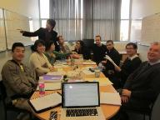

Challenges: Where learning takes place has changed.
Students are spending a lot more time on line.
On Line
Flipped Classroom
Blended Classroom
Interactive
Suitable for students with some familiarity with the issues
Suitable for students with some familiarity with the issues
Case-Based
Traditional
Guided
Suitable for students with relevant expertise
Suitable for students new to the subject
Unstructured
Structured
In Class

Slide 40
Fundamental challenges
Changing role of HLI in a rapidly changing world
  How to be a brain trust?
  Switching from knowing to be platform building – academics (beyond business schools), industry, students
Governance and incentive problems
  Murky performance measures
  Faculty matter
    Whom do they work for? Their stakeholders?
    The internet world interferes – winner take all !
Develop intrinsic value
  Care, sense of ownership, sense of purpose
  Confucius:“君子喻于义，小人喻于利。”

Slide 41

Thanks for listening

Slide 42

Vision: Dual Channel Strategies to engage students
Experiential Learning
inside classroom
Engaged Learning
outside classroom
Ask Questions
Check understanding and success rate
Independent practice
Deeper level of appreciation
Interaction!
New material in small steps
Provide models
Scaffold for difficult tasks
Collaborative life-long learning Skills

Slide 43
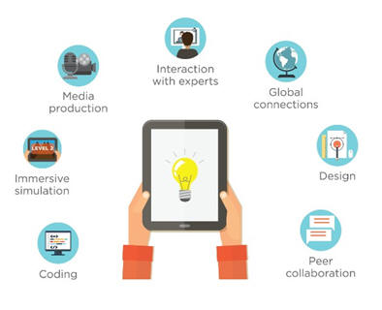
Challenge to Education
Communication technology changes teaching
  Expanded space for interactions
  Expanded visual impact
  Expanded integration of data, experience and learning
    But, old stories, faculty do all these on their own
    Need to have assurance of learning

Slide 44
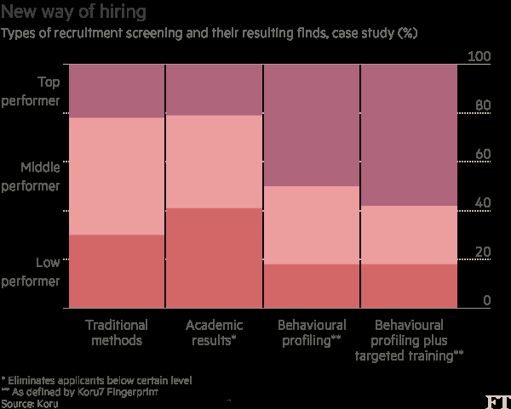
Students who succeed:

Slide 45

Indicators for success
Key indicators in Koru’s behavioral proﬁling Skill Description
  Rigorous thinking
  Holding analytical skills and ability to mine data
  Curiosity
  Capacity to learn quickly, also creative and innovative
  Sense of ownership
  Takes initiative in the service of others
  Teamwork Collaborates eﬀectively with colleagues
  Polish Communicates professionally and conﬁdently Impact
  Ability to use time eﬃciently and target resources
  Grit tenacious and resilient in fast-paced environment

Slide 46
Level the playing field but winners take more
Market concentration
  Alibaba is a great example
  10% of the world’s public companies generate 80% of all profits (The McKinsey Global Institute),
  The five largest banks share of America’s banking assets increases from 25% in 2000 to 45% 2016
  The share of nominal GDP generated by the Fortune 100 American companies rose from about 33% of GDP in 1994 to 46% in 2013

Slide 47
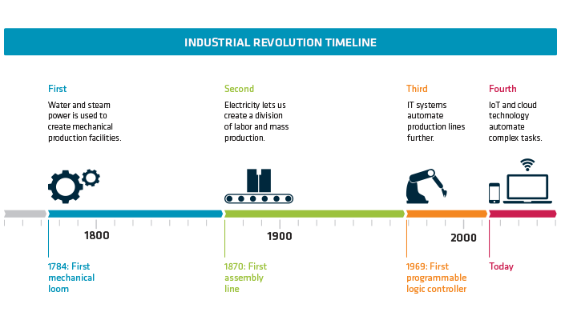

Slide 48
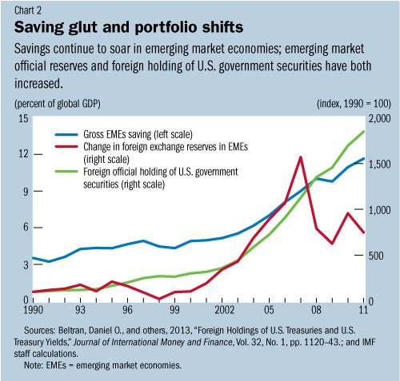
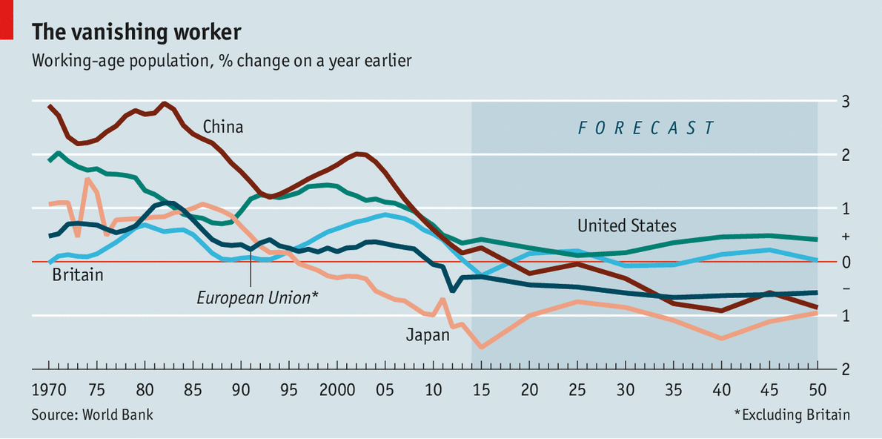
Exciting investment prospects but 3 low (investment, return, growth) and 2 high (savings, cashholding)
Two hypotheses: the secular stagnation and savings glut hypotheses
  Technological progress and ageing populations shrink investment opportunities
  Savings
    policy-distorted high savings from emerging economies
    longer life expectations = need more savings, and low interest rate raises the pension burden.
Notes:
See Larry Summers, http://larrysummers.com/2016/02/17/the-age-of-secular-stagnation/
See Ben Bernanke https://www.brookings.edu/blog/ben-bernanke/2015/04/01/why-are-interest-rates-so-low-part-3-the-global-savings-glut/.
There will be no shortage of industry survey showing firms are investing in “things” of the Fourth Industrial Revolutions. However, note that these surveys often have a sampling bias. Furthermore, Figure 1.13 of IMF’s World Economic Outlook April 2016 show that the world’s real investment has been flat since 2010, and that is the case for advanced countries or Emerging and Developing Economies.
Thomas Piketty’s Capital in the Twenty-First Century (2014) draws our attention to the rising share of capital income and rising economic disparity. The culprit is a highly elastic substitution between capital and labour. When the substitution is too elastic, technological progresses can reduce labour income share and earnings.
Future technological progresses may do exactly that. “Uberization” likely reduces the number of cars needed. With driverless cars, Uber does not need to employ drivers to deliver an adequate car-ride service. The result is high job-displacement at low capital-cost where the capital owner gains handsomely. The gain is even greater if big data analysis allows greater extraction of consumer surplus, e.g., the ride fare doubles in heavy rain.
Consider also the introduction of robot adviser in selling insurance – the marginal training and monitoring cost are extremely low once the upfront investment is incurred. By introducing robot adviser developed in the US to sell insurance in China, an insurance company can cover the whole of China at very low marginal investment cost - a significant advantage in comparison to developing real-life insurance sales agents. The result is that any company introducing the innovation could capture a lion’s share of the China insurance market, while many Chinese insurance sales agents lose their jobs.
These stories illustrate how the current technological revolution may drive high capital labour substitution resulting in large-scale job destruction and wide income disparity in favour of capital owners and high-end professionals. Indeed, the revolution heightens the winner-takes-all phenomenon. Needless to say, such high income disparity is undesirable and can lead to a vicious cycle that further retards job creation.
Generating inclusive growth is a non-trivial challenge in the age of Fourth Industrial Revolution. Our government has to raise Singaporeans’ awareness of the need, and to stimulate their effort, to adjust in advance: develop skills that complement technological innovations and avoid building their livelihood on skills that are machine substitutable.
Our government has to encourage Singaporeans to develop skills that complement technological innovations and avoid building their livelihood on skills that are machine substitutable.
High elasticity of substitution means that laborers can be easily replaced by machines at low investment cost. In such a case, capital investment reduces labor income share.
There are plenty of examples of corporate heroes becoming zeros: think of BlackBerry, Blockbuster, Borders and Barings, to name just four that begin with a “b”.

Slide 49
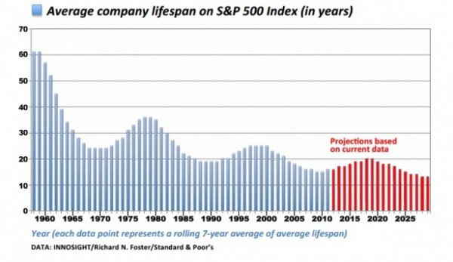
Exciting investment prospects but 3 low (investment, return, growth) and 2 high (savings, cashholding)
Overtly rapid disruption may be another explanatory factor
  Investment
    Expectations of highly frequent disruptive innovations → high risk and short life-span of usefulness for investments.
    Innovation is based on information asymmetry, associated investment is difficult to value,
    Implications:
      discourages investment;
      the appetite for expansion investments and even for depreciation replenishment is also reduced
      finance is by and large based on internal cash;
  Savings:
    Wide spread and elastic substitution of machines for jobs reduces job security, AI have spread this fear from blue collar to white collar workers, including banking, insurance, lawyers, accounting, and even doctors
    Implication = save more
Notes:
See Larry Summers, http://larrysummers.com/2016/02/17/the-age-of-secular-stagnation/
See Ben Bernanke https://www.brookings.edu/blog/ben-bernanke/2015/04/01/why-are-interest-rates-so-low-part-3-the-global-savings-glut/.
There will be no shortage of industry survey showing firms are investing in “things” of the Fourth Industrial Revolutions. However, note that these surveys often have a sampling bias. Furthermore, Figure 1.13 of IMF’s World Economic Outlook April 2016 show that the world’s real investment has been flat since 2010, and that is the case for advanced countries or Emerging and Developing Economies.
Thomas Piketty’s Capital in the Twenty-First Century (2014) draws our attention to the rising share of capital income and rising economic disparity. The culprit is a highly elastic substitution between capital and labour. When the substitution is too elastic, technological progresses can reduce labour income share and earnings.
Future technological progresses may do exactly that. “Uberization” likely reduces the number of cars needed. With driverless cars, Uber does not need to employ drivers to deliver an adequate car-ride service. The result is high job-displacement at low capital-cost where the capital owner gains handsomely. The gain is even greater if big data analysis allows greater extraction of consumer surplus, e.g., the ride fare doubles in heavy rain.
Consider also the introduction of robot adviser in selling insurance – the marginal training and monitoring cost are extremely low once the upfront investment is incurred. By introducing robot adviser developed in the US to sell insurance in China, an insurance company can cover the whole of China at very low marginal investment cost - a significant advantage in comparison to developing real-life insurance sales agents. The result is that any company introducing the innovation could capture a lion’s share of the China insurance market, while many Chinese insurance sales agents lose their jobs.
These stories illustrate how the current technological revolution may drive high capital labour substitution resulting in large-scale job destruction and wide income disparity in favour of capital owners and high-end professionals. Indeed, the revolution heightens the winner-takes-all phenomenon. Needless to say, such high income disparity is undesirable and can lead to a vicious cycle that further retards job creation.
Generating inclusive growth is a non-trivial challenge in the age of Fourth Industrial Revolution. Our government has to raise Singaporeans’ awareness of the need, and to stimulate their effort, to adjust in advance: develop skills that complement technological innovations and avoid building their livelihood on skills that are machine substitutable.
Our government has to encourage Singaporeans to develop skills that complement technological innovations and avoid building their livelihood on skills that are machine substitutable.
High elasticity of substitution means that laborers can be easily replaced by machines at low investment cost. In such a case, capital investment reduces labor income share.
There are plenty of examples of corporate heroes becoming zeros: think of BlackBerry, Blockbuster, Borders and Barings, to name just four that begin with a “b”.

